Slide 1


CAN EXERCISE MAKE OUR CHILDREN SMARTER?
Nenad Stojiljković, PhD
Petar Mitić, PhD
Goran Sporiš, PhD

Slide 2
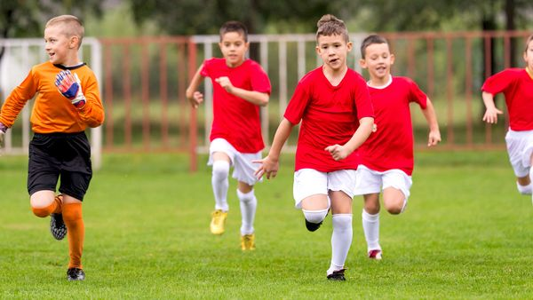

BRAIN AND EXERCISE
Is there a link between exercise and brain?
Is there a link between academic performance and fitness level?
Many hours in the gym will increase our physical abilities… but what will happen with our brain?
What type of activities can influence brain structures and function?
How can we describe the changes in the brain caused by the exercise?

Slide 3
BENEFITS OF EXERCISE
Improve fitness (strength, power, speed, agility, balance, endurance, coordination)
Improve body composition of children
Enhances self-esteem
Lead to better academic performance
Improves cognitive functions of children
?

Slide 4
EXERCISE ENHANCE BRAIN PLASTICITY
Definition of Neuroplasticity:
The brain's ability to reorganize itself by forming new neural connections throughout life. Neuroplasticity allows the neurons (nerve cells) in the brain to compensate for injury and disease and to adjust their activities in response to new situations or to changes in their environment.

Slide 5


SUPERCALIFRAGILISTICEXPIALIDOCIOUS
The Oxford English Dictionary first records the word in a column by Helen Herman in the Syracuse University Daily Orange, dated March 10, 1931.
In the column, Herman states that the word "implies all that is grand, great, glorious, splendid, superb, wonderful"

Slide 6
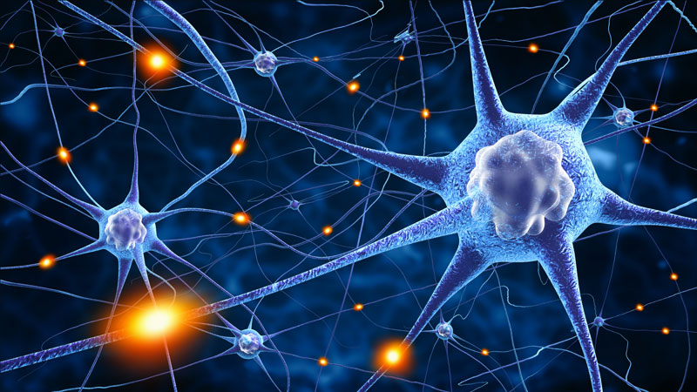
BRAIN PLASTICITY AND LEARNING
1. New brain cells are constantly formed
2. Learning leads to newer connections in the brain
3. The brain is highly plastic
Researchers observed that during process of learning motor tasks new synapses being formed in the pyramidal neurons of the motor cortex and their growth strengthed as the participants learned their task. These neurons also persisted after the learning was discontinued. Thus, clearly suggesting that a cluster of new neurons were formed as a direct consequence of learning the task at hand.

Slide 7

SUPERCALIFRAGILISTICEXPIALIDOCIOUS
The Oxford English Dictionary first records the word in a column by Helen Herman in the Syracuse University Daily Orange, dated March 10, 1931.
In the column, Herman states that the word "implies all that is grand, great, glorious, splendid, superb, wonderful"

Slide 8
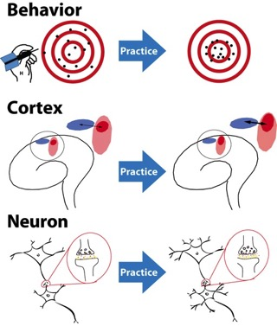
BRAIN PLASTICITY
Brain plasticity (from the Greek word ‘plastos’ meaning molded) refers to the extraordinary ability of the brain to modify its own structure and function following changes within the body or in the external environment. The large outer layer of the brain, known as the cortex is especially able to make such modifications.

Slide 9

ROOTS OF A MIND–BODY CONNECTION
In ancient Greece fitness was almost as important as learning itself.
The Greeks were clued into "the mind-body connection." And they probably intuited a basic principle that Western researchers also figured out long ago: aerobic exercise helps the heart pump more blood to the brain, along with the rest of the body. More blood means more oxygen, and thus better-nourished brain cells. For decades, that has been the only link between athletic and mental prowess that science has been able to demonstrate with any degree of certainty.

Slide 10
BRAIN AND EXERCISE
The brain is inherently plastic, adaptable, changeable.
BUT
effects of physical activity on brain and cognition are not uniform
some brain areas and cognitive domains are more consistently influenced by physical activity than others

Slide 11
BRAIN AND EXERCISE
The first systematic examination of the physical activity and brain relationship began in the 1970s, with findings indicating that older adults who regularly participated in physical activity had faster psychomotor speed, relative to their sedentary counterparts, on simple and choice reaction-time tests.
Interestingly, no such relationship was observed in comparable groups of younger adults, suggesting that the benefits of physical activity on cognition were specific to older adults.

Slide 12
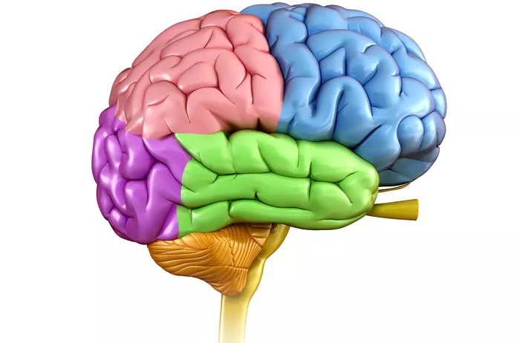
BRAIN STRUCTURES AND FUNCTIONS
The frontal lobe
The parietal lobe
The temporal lobe
The occipital lobe

Slide 13
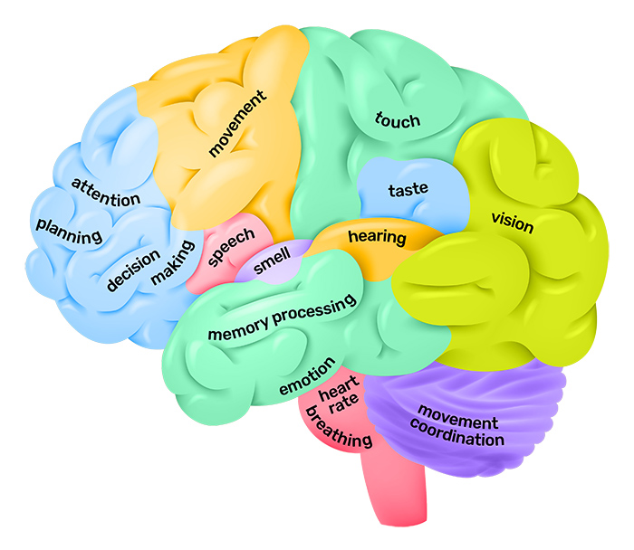
BRAIN STRUCTURES AND FUNCTIONS
The cerebral cortex is the part of the brain that functions to make human beings unique.
Distinctly human traits including higher thought, language, and human consciousness as well as the ability to think, reason and imagine all originate in the cerebral cortex.

Slide 14
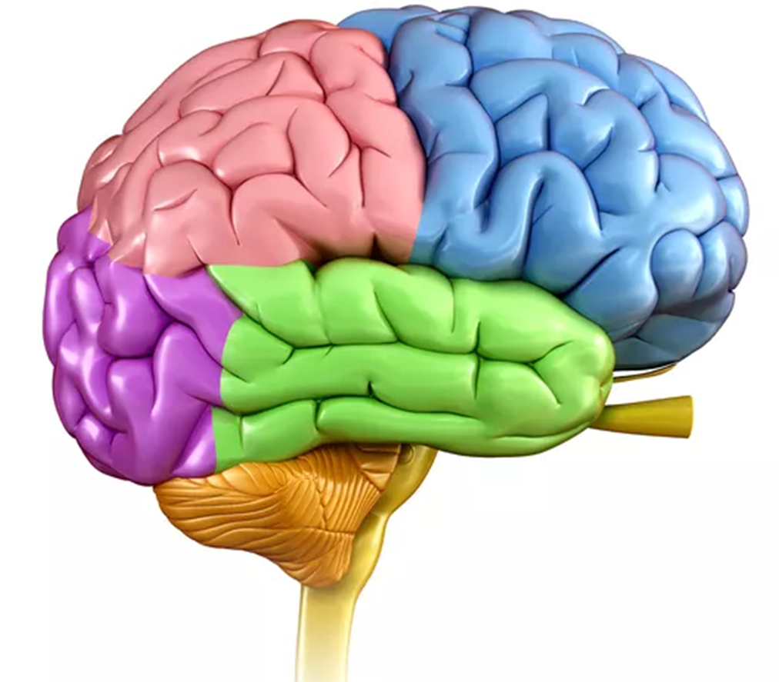
BRAIN STRUCTURES AND FUNCTIONS
The frontal lobe is located at the front of the brain. Parts of the brain that control thinking and memory (the prefrontal cortex and medial temporal cortex) have greater volume in people who exercise
Associated with reasoning, motor skills, higher level cognition, and expressive language.
At the back of the frontal lobe, near the central sulcus, lies the motor cortex. This area of the brain receives information from various lobes of the brain and utilizes this information to carry out body movements. The motor cortex is the region of the cerebral cortex involved in the planning, control, and execution of voluntary movements.

Slide 15
BRAIN STRUCTURES AND FUNCTIONS
The parietal lobe is located in the middle section of the brain
Associated with processing tactile sensory information such as pressure, touch, and pain.
A portion of the brain known as the somatosensory cortex is located in this lobe and is essential to the processing of the body's senses.

Slide 16
BRAIN STRUCTURES AND FUNCTIONS
The temporal lobe is located on the bottom section of the brain. This lobe is also the location of the primary auditory cortex, which is important for interpreting sounds and the language we hear.
The hippocampus is also located in the temporal lobe, which is why this portion of the brain is also heavily associated with the formation of memories. Damage to the temporal lobe can lead to problems with memory, speech perception, and language skills.

Slide 17
BRAIN STRUCTURES AND FUNCTIONS
The occipital lobe is located at the back portion of the brain and is associated with interpreting visual stimuli and information.
The primary visual cortex, which receives and interprets information from the retinas of the eyes, is located in the occipital lobe. Damage to this lobe can cause visual problems such as difficulty recognizing objects, an inability to identify colors, and trouble recognizing words.

Slide 18
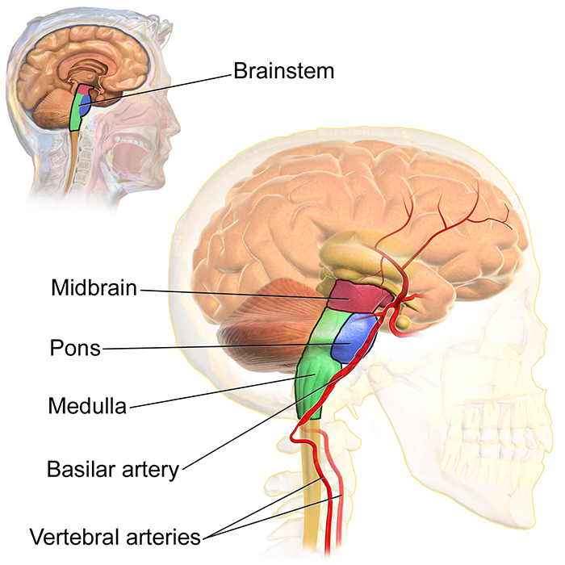
BRAIN STRUCTURES AND FUNCTIONS
The midbrain is often considered the smallest region of the brain. It acts as a sort of relay station for auditory and visual information. The midbrain controls many important functions such as the visual and auditory systems as well as eye movement.
Portions of the midbrain called the red nucleus and the substantia nigra are involved in the control of body movement.
The darkly pigmented substantia nigra contains a large number of dopamine-producing neurons are located. The degeneration of neurons in the substantia nigra is associated with Parkinson’s disease

Slide 19
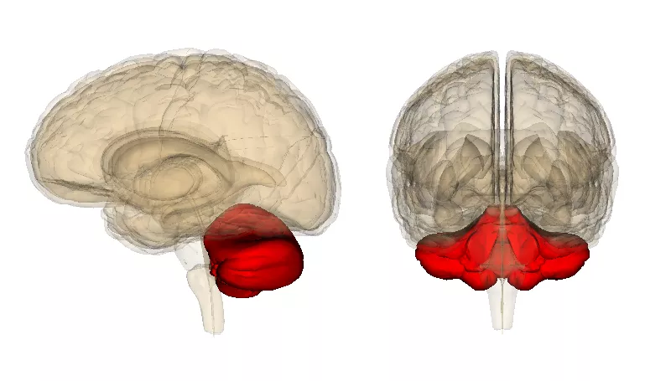
BRAIN STRUCTURES AND FUNCTIONS
The cerebellum makes up approximately 10 percent of the brain's total size, but it accounts for more than 50 percent of the total number of neurons located in the entire brain.
﻿This structure is associated with motor movement and control, but this is not because the motor commands originate here. Instead, the cerebellum serves to modify these signals and make motor movements accurate and useful.

Slide 20
BRAIN STRUCTURES AND FUNCTIONS
The cerebellum helps control posture, balance, and the coordination of voluntary movements. This allows different muscle groups in the body to act together and produce coordinated fluid movement.
In addition to playing an essential role in motor control, the cerebellum is also important in certain cognitive functions including speech.

Slide 21
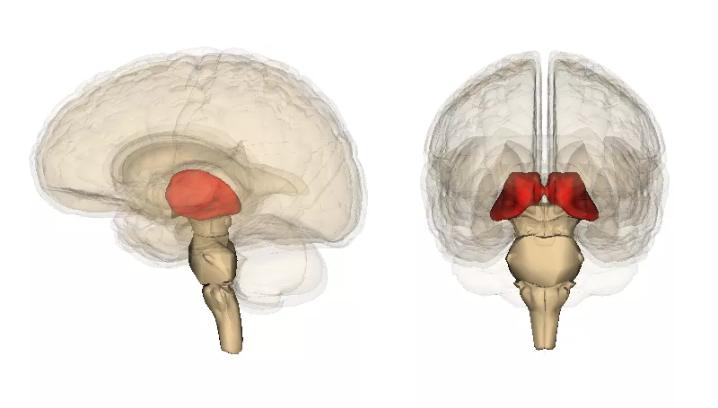
BRAIN STRUCTURES AND FUNCTIONS
Located above the brainstem, the thalamus processes and transmits movement and sensory information.
﻿It is essentially a relay station, taking in sensory information and then passing it on to the cerebral cortex. The cerebral cortex also sends information to the thalamus, which then sends this information to other systems.

Slide 22
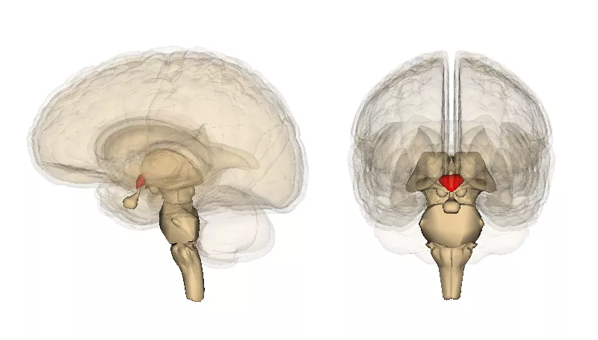
BRAIN STRUCTURES AND FUNCTIONS
The hypothalamus is a grouping of nuclei that lie along the base of the brain near the pituitary gland.
The hypothalamus connects with many other regions of the brain and is responsible for controlling hunger, thirst, emotions, body temperature regulation, and circadian rhythms.
﻿﻿The hypothalamus also controls the pituitary gland by secreting hormones, which gives the hypothalamus a great deal of control over many body functions.

Slide 23
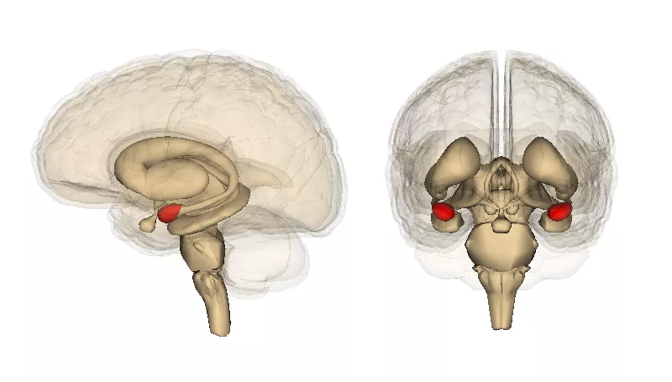
BRAIN STRUCTURES AND FUNCTIONS
The Limbic System
The amygdala
The hippocampus
Regions of the limbic cortex
The septal area

Slide 24
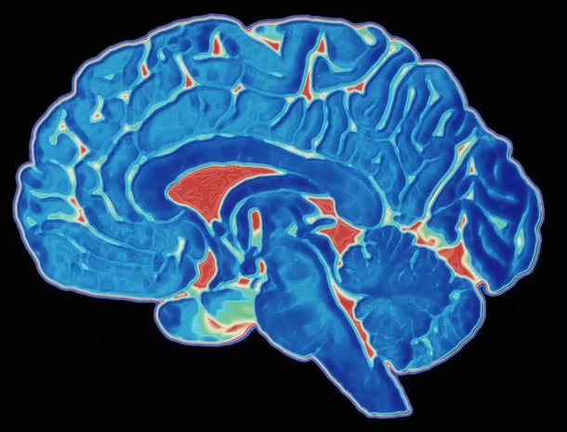
BRAIN STRUCTURES AND FUNCTIONS
The basal ganglia are a group of large nuclei that partially surround the thalamus. These nuclei are important in the control of movement.﻿ The red nucleus and substantia nigra of the midbrain have connections with the basal ganglia.

Slide 25
THE RELATIONSHIP BETWEEN PHYSICAL ACTIVITY AND COGNITION IN CHILDREN
Benjamin A. Sibley and Jennifer L. Etnier: The Relationship Between Physical Activity and Cognition in Children: A Meta-Analysis. Pediatric Exercise Science, 2003, 15, 243-256.
This meta-analysis determined a positive relation between physical activity and cognitive performance in school-age children (aged 4–18 years) in eight measurement categories:
perceptual skills,
intelligence quotient,
achievement,
verbal tests,
mathematic tests,
memory,
developmental level/academic readiness and
other

Slide 26
THE RELATIONSHIP BETWEEN PHYSICAL ACTIVITY AND COGNITION IN CHILDREN
A beneficial relationship was found for all categories, with the exception of memory, which was unrelated to physical activity behaviour, and for all age groups (although it was stronger for children in the age ranges of 4–7 and 11–13 years, compared with the age ranges of 8–10 and 14–18 years).
The effect size (ES) observed by Sibley and Etnier in their meta-analysis was 0.32, which is similar to that which was observed in a meta-analysis of the effects of physical activity on cognition (ES = 0.25) across the lifespan (6–90 years).
These findings suggest that although physical activity might be beneficial at all stages of life, early intervention might be important for the improvement and/or maintenance of cognitive health and function throughout the adult lifespan.

Slide 27
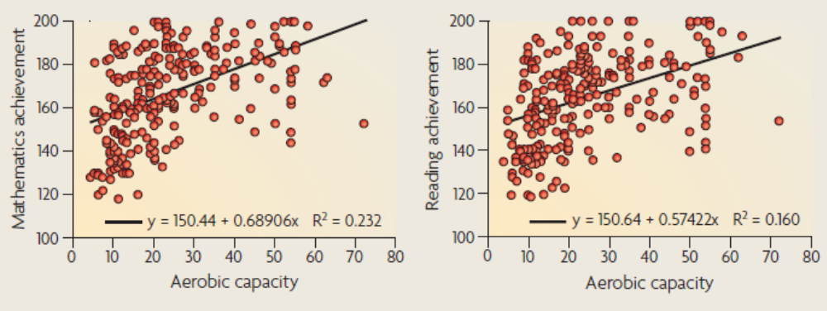
THE RELATIONSHIP BETWEEN PHYSICAL ACTIVITY AND COGNITION IN CHILDREN

Slide 28
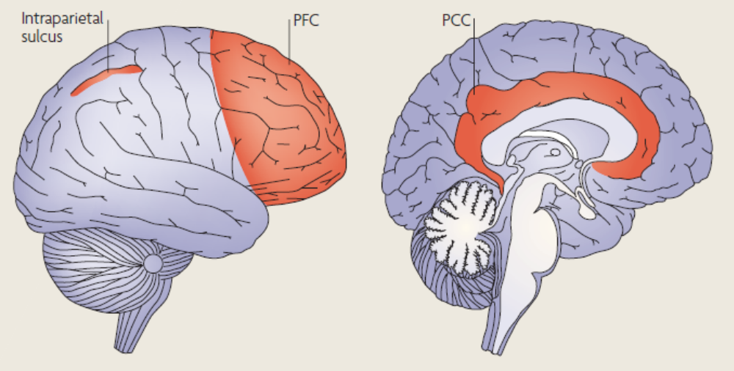
THE RELATIONSHIP BETWEEN PHYSICAL ACTIVITY AND COGNITION IN CHILDREN
Regions of brain activated during the mathematical calculation and reading. Given that both mathematics and reading elicit activation in the frontoparietal network, there is a sound basis for examining these structures in relation to academic performance.
As fitness has also been related to the frontoparietal network, it would follow that children might derive benefits in school performance from increased participation in physical activity.
Notes:
Relevant neural networks have been identified for component processes that might be involved in mathematics and reading performance. Research that examined the functional neuroanatomy of reading comprehension revealed an activation of the prefrontal cortex (PFC) and parietal/posterior cingulate cortex (PCC). Likewise, mathematical calculations and numerical magnitude processing have been linked to bilateral regions of the intraparietal sulcus in children and adults. However, children also recruit the right dorsolateral prefrontal cortex. Given that both mathematics and reading elicit activation in the frontoparietal network, there is a sound basis for examining these structures in relation to academic performance.
As fitness has also been related to the frontoparietal network, it would follow that children might derive benefits in school performance from increased participation in physical activity.

Slide 29
HOW BRAIN CAN BENEFIT FROM EXERCISE
Positive effects of physical activity
Molecular level
Cellular level
Systems level
Behavioral level

Slide 30
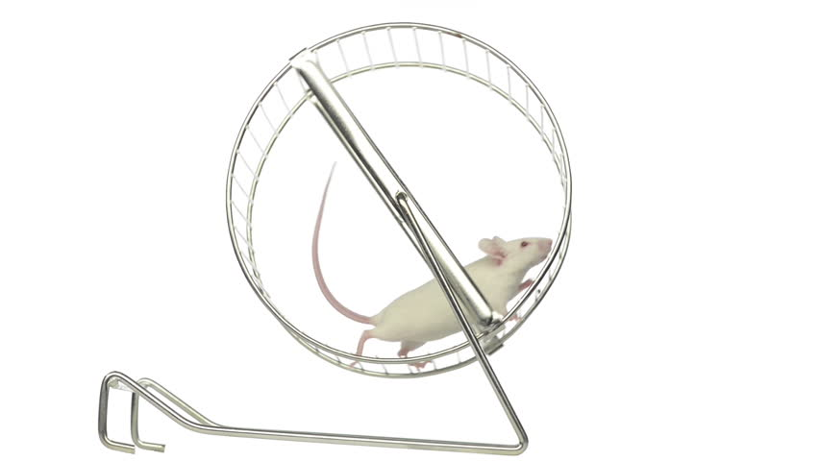
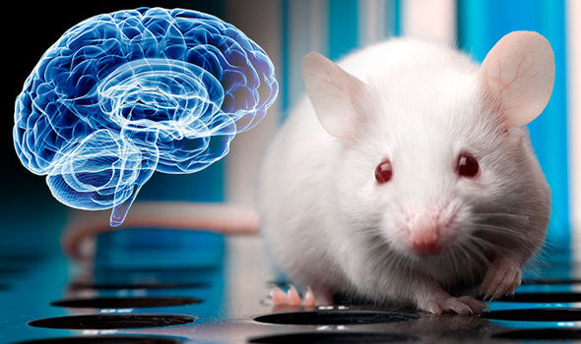
BENEFITS OF EXERCISE
Researches of effects of physical activity on animals

Slide 31
BENEFITS OF EXERCISE
Researches of effects of physical activity on animals
positive effect on neuronal growth
positive effect on the neural systems that are involved in learning and memory
angiogenesis
Notes:
Exercise influences brain vasculature. In particular, physical activity increases the proliferation of brain endothelial cells and angiogenesis throughout the brain [5]. The growth factors insulin-like growth factor (IGF) and vascular endothelial growth factor (VEGF) have an important role in the angiogenic and neurogenic effects of exercise on the brain. Running enhances hippocampal IGF gene expression [75] and increases serum levels of both IGF [75] and VEGF [76]. These factors also play an important part in hippocampal neurogenesis. Hippocampal gene transfer of VEGF [77] and peripheral infusion of IGF-1 enhanced neurogenesis [78]. Blockade of peripheral VEGF and IGF-1 inhibited the increase in neurogenesis observed with running

Slide 32
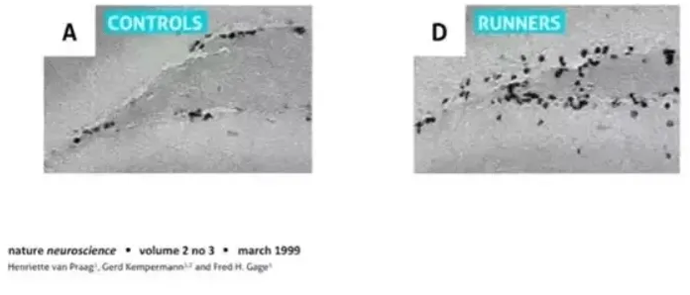
BENEFITS OF EXERCISE
In one of the first studies to highlight the links between aerobics and neurogenesis, Rusty Gage of the Salk Institute examined new brain cell growth in mice. The ‘control’ mice had no running wheel in their cages, while the ‘runners’ were able to run in their cages regularly. In the snapshots below, from Gage’s experiment, the black dots are new neurons-to-be.
Notes:
Exercise influences brain vasculature. In particular, physical activity increases the proliferation of brain endothelial cells and angiogenesis throughout the brain [5]. The growth factors insulin-like growth factor (IGF) and vascular endothelial growth factor (VEGF) have an important role in the angiogenic and neurogenic effects of exercise on the brain. Running enhances hippocampal IGF gene expression [75] and increases serum levels of both IGF [75] and VEGF [76]. These factors also play an important part in hippocampal neurogenesis. Hippocampal gene transfer of VEGF [77] and peripheral infusion of IGF-1 enhanced neurogenesis [78]. Blockade of peripheral VEGF and IGF-1 inhibited the increase in neurogenesis observed with running

Slide 33
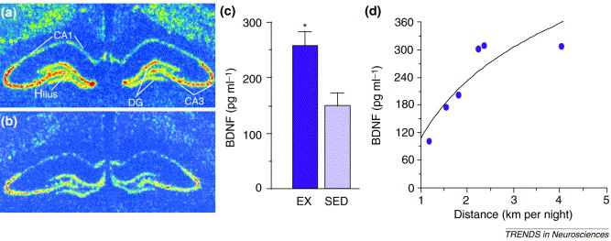
Effects of exercise on hippocampal brain-derived neurotrophic factor (BDNF) mRNA and protein levels.
a) In situ hybridization shows that expression of BDNF mRNA in the rat dentate gyrus (DG), hilus, CA1–CA3 regions and cortex is greater following exercise (seven days of voluntary wheel-running) than in sedentary animals (b).
c) hippocampal BDNF protein levels in the hippocampus in sedentary (SED) and exercising (EX) animals, after five days of wheel-running (*P <0.05).
d) Rats and mice acclimate rapidly to the running wheel and progressively increase their extent of daily running, in some cases up to a startling 20 kilometers (∼12–13 miles) per night. BDNF protein levels correlate with running distance (average over 14 days running; R2 = 0.771)
Notes:
Effects of exercise on hippocampal brain-derived neurotrophic factor (BDNF) mRNA and protein levels. (a) In situ hybridization shows that expression of BDNF mRNA in the rat dentate gyrus (DG), hilus, CA1–CA3 regions and cortex is greater following exercise (seven days of voluntary wheel-running) than in sedentary animals (b). (c) ELISA quantification of hippocampal BDNF protein levels in the hippocampus in sedentary (SED) and exercising (EX) animals, after five days of wheel-running (*P <0.05). (d) Rats and mice acclimate rapidly to the running wheel and progressively increase their extent of daily running, in some cases up to a startling 20 kilometers (∼12–13 miles) per night. BDNF protein levels correlate with running distance (average over 14 days running; R2 = 0.771)

Slide 34
BRAIN CHANGES ON MOLECULAR LEVEL
Several molecular systems could potentially participate in the benefits of exercise on the brain. Neurotrophic factors have most of the properties that could underlie such beneficial effects.
Brain-derived neurotrophic factor (BDNF) supports the survival and growth of many neuronal subtypes, including glutamatergic neurons.
As the neurotrophin field evolved, BDNF emerged as a key mediator of synaptic efficacy, neuronal connectivity and use-dependent plasticity.
Notes:
Glutamatergic neurons produce glutamate, which is one of the most common excitatory neurotransmitters in the central nervous system (CNS). vGluT1. A glutamate transporter that transports cytoplasmic glutamate into vesicles.

Slide 35
BRAIN CHANGES ON MOLECULAR LEVEL
Exercise influences brain vasculature (angiogenesis). In particular, physical activity increases the proliferation of brain endothelial cells and angiogenesis throughout the brain.
The growth factors insulin-like growth factor (IGF) and vascular endothelial growth factor (VEGF) have an important role in the angiogenic and neurogenic effects of exercise on the brain. Running enhances hippocampal IGF gene expression and increases serum levels of both IGF and VEGF. These factors also play an important part in hippocampal neurogenesis. Hippocampal gene transfer of VEGF and peripheral infusion of IGF-1 enhanced neurogenesis.

Slide 36
BRAIN CHANGES ON MOLECULAR LEVEL
Researchers predicted that a neurotrophin-mediated response to exercise would probably be restricted to motor–sensory systems of the brain, such as the cerebellum, primary cortical areas or basal ganglia.
The findings were surprising: several days of voluntary wheel-running increased levels of BDNF mRNA in the hippocampus, a highly plastic structure that is normally associated with higher cognitive function rather than motor activity. The changes in mRNA levels were found in neurons, particularly those of the dentate gyrus (DG), hilus and CA3 region.

Slide 37
BRAIN CHANGES ON MOLECULAR LEVEL
Increased levels of BDNF mRNA appeared within days in both male and female rats, were sustained even after several weeks of exercise, and were paralleled by increased amounts of BDNF protein.
Although other trophic factors, including nerve growth factor (NGF) and fibroblast growth factor 2 (FGF-2), were also induced in the hippocampus in response to exercise, their upregulation was transient and less robust than that of BDNF, suggesting that BDNF is a better candidate for mediating the long-term benefits of exercise on the brain.

Slide 38
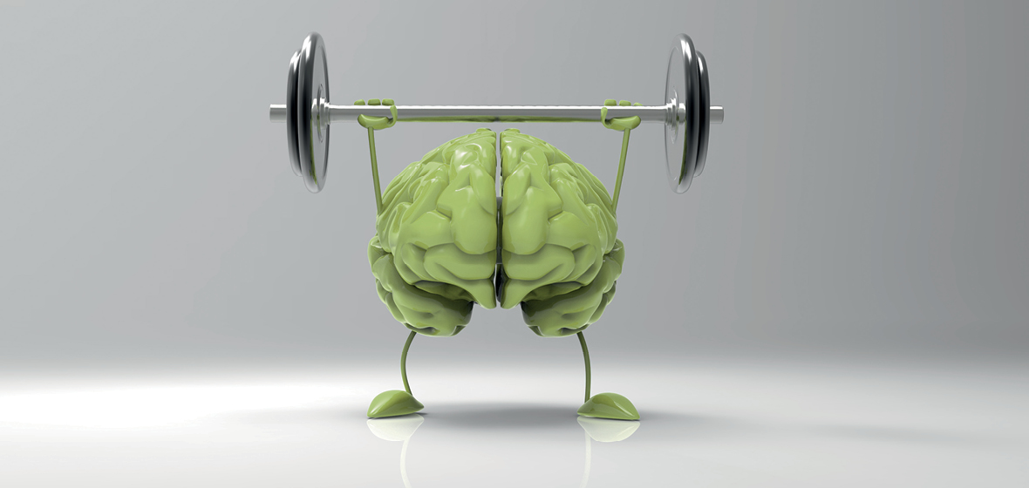
EXERCISE AS STIMULATION OF BRAIN DEVELOPMENT
Exercise stimulate brain growth and boost cognitive performance.
We don’t know exactly which exercise is the best.
How much exercise is required to improve memory?

Slide 39
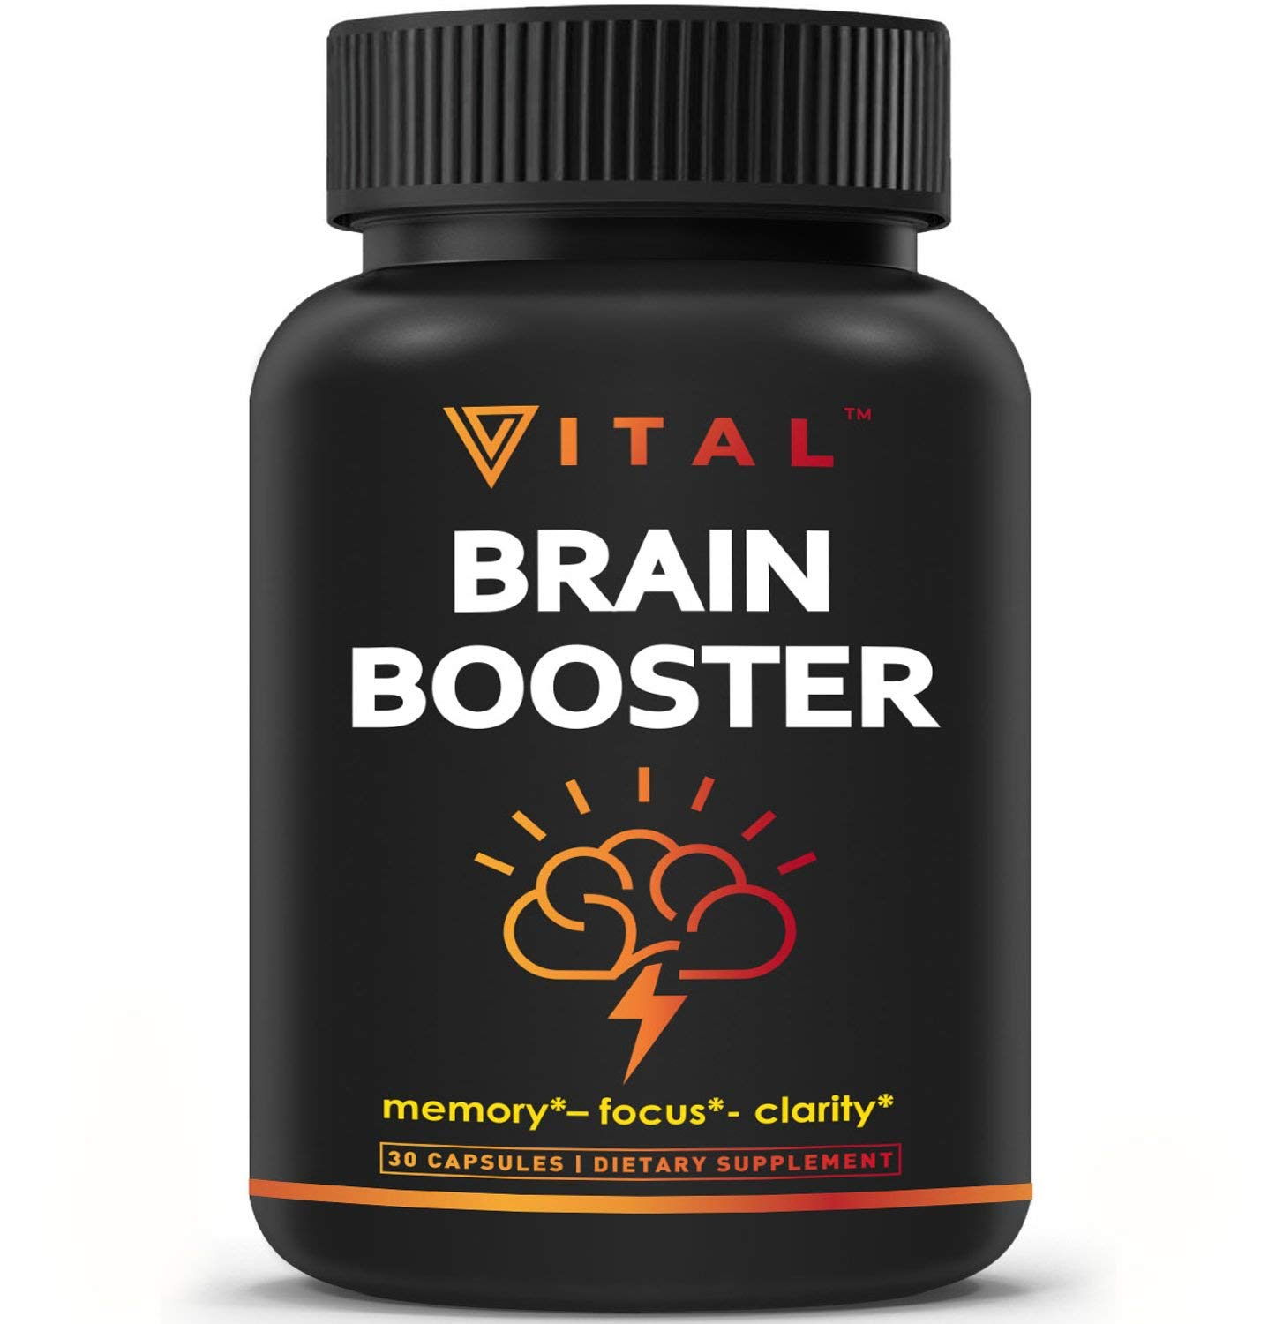
EXERCISE AS NOOTROPIC
Exercise is natural nootropic
Nootropics (/noʊ.əˈtrɒpɪks/ noh-ə-TROP-iks) (colloquial: smart drugs and cognitive enhancers) are drugs, supplements, and other substances that may improve cognitive function, particularly executive functions, memory, creativity, or motivation, in healthy individuals.

Slide 40
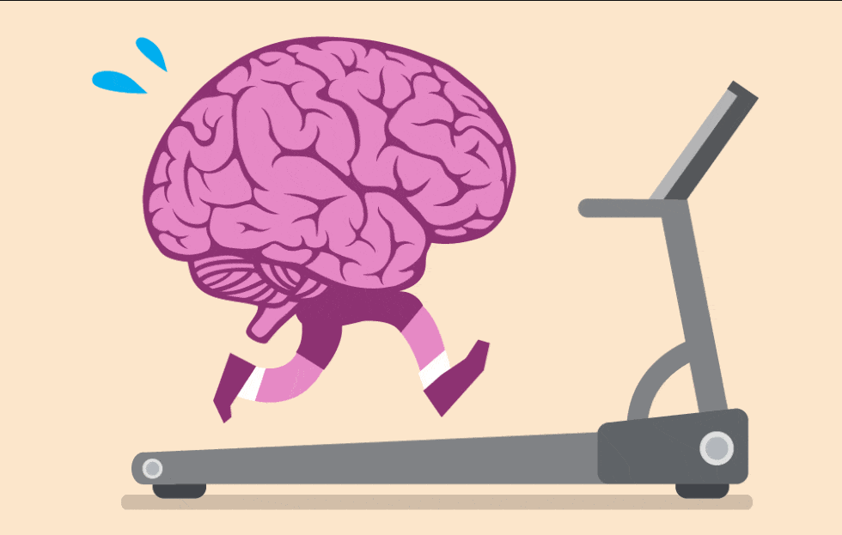
PHYSICAL ACTIVITY CAN INCREASE LEVEL OF BRAIN DERIVED NEUROTROPHIC FACTOR
Brain-derived neurotrophic factor (BDNF) plays an important role in neuronal survival and growth, serves as a neurotransmitter modulator, and participates in neuronal plasticity, which is essential for learning and memory. It is widely expressed in the CNS, gut and other tissues.
BDNF
VEGF
IGF 1

Slide 41
PHYSICAL ACTIVITY CAN INCREASE LEVEL OF BRAIN DERIVED NEUROTROPHIC FACTOR
Another possible influence of exercise on brain is related to the increased concentrations of the brain derived neurotrophic factor (BDNF), IGF-1 and vascular endothelial-derived growth factor (VEGF).
This three growth factors belongs to the group of neurotrophins that are important to the development and maintenance of functioning of neural cells in the brain. BDNF is the major mediator of the impact of aerobic exercise on hippocampal neuroplasticity and functioning
Effects of exercise on learning is mostly regulated by IGF-1 and BDNF.
Stimulation of angiogenesis and hippocampal neurogenesis caused by exercise is regulated by IGF-1 and VEGF

Slide 42
PHYSICAL ACTIVITY CAN INCREASE LEVEL OF BRAIN DERIVED NEUROTROPHIC FACTOR
One of the recent study shows that BDNF is the crucial for hippocampal function, synaptic plasticity, learning and modulation of depression
Level of BDNF in different regions of brain can increase by exercise. The greatest increase of BDNF occur in the hippocampus, and after few days of regular exercise BDNF production is increased in all hippocampal subfields. This increase of BDNF can be maintained for weeks with regular exercising
Similar to increase of BDNF exercise can influence the increase of IGF-1 in hippocampal neurons and this level can maintain several days after exercise. Exercise induce rapid increase of peripheral circulating levels of IGF-1 which is the key factor of exercise induced neurogenesis and improved memory
Some studies consider BDNF and IGF-1 as exercise induced mediator that has the main impact on behavioral improvements, while the exercise induced neurogenesis and angiogenesis are regulated predominantly by mutual influence of IGF-1 and vascular endothelial-derived growth factor (VEGF). This two growth factors increase their levels by exercise in the periphery and cross the blood-brain barrier to enter the brain.

Slide 43
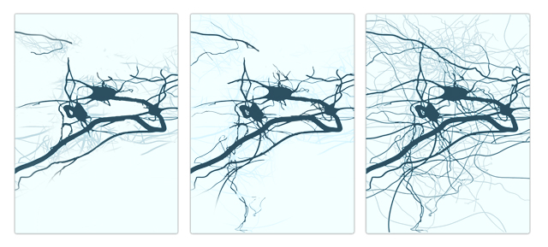
EXERCISE PLAYS A PROFOUND ROLE IN NEURONAL PLASTICITY
The researchers used different methods including brain scans, EEG recordings, and blood as well as saliva sampling to investigate the exercise-induced brain activity and volume changes in different brain areas including frontal and central regions of the brain, the hippocampus, cerebellum, and the motor cortex.

Slide 44
MEASURING OF COGNITIVE PROCESSES
The majority of studies in this area have relied heavily on the use of behavioural performance measures (i.e. response accuracy and reaction time) as indicators of cognitive performance. Although these measures have undoubtedly enhanced our ability to answer the question of whether or not exercise has a beneficial effect on cognition, it remains challenging to make definitive conclusions about the subtle aspects of cognitive processing that are influenced by exercise, since behavioural measures represent end-state processes.
paper-and-pencil tests
computer-based tests

Slide 45
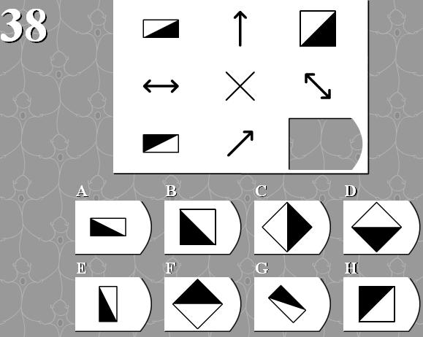

MEASURING OF COGNITIVE PROCESSES

Slide 46
NEUROIMAGING TECHNIQUES
Event-related brain potentials (ERP). An event-related potential (ERP) is the measured brain response that is the direct result of a specific sensory, cognitive, or motor event. More formally, it is any stereotyped electrophysiological response to a stimulus. The study of the brain in this way provides a noninvasive means of evaluating brain functioning.
Structural and functional MRI

Slide 47
EVENT-RELATED POTENTIALS
Event-related potentials (ERPs) are very small voltages generated in the brain structures in response to specific events or stimuli. They are EEG changes that are time locked to sensory, motor or cognitive events that provide safe and noninvasive approach to study psychophysiological correlates of mental processes. Event-related potentials can be elicited by a wide variety of sensory, cognitive or motor events. They are thought to reflect the summed activity of postsynaptic potentials produced when a large number of similarly oriented cortical pyramidal neurons (in the order of thousands or millions) fire in synchrony while processing information.

Slide 48
EVENT-RELATED POTENTIALS
Event-related potentials (ERPs) in humans can be divided into 2 categories. The early waves, or components peaking roughly within the first 100 milliseconds after stimulus, are termed ‘sensory’ or ‘exogenous’ as they depend largely on the physical parameters of the stimulus. In contrast, ERPs generated in later parts reflect the manner in which the subject evaluates the stimulus and are termed ‘cognitive’ or ‘endogenous’ ERPs as they examine information processing. The waveforms are described according to latency and amplitude.

Slide 49
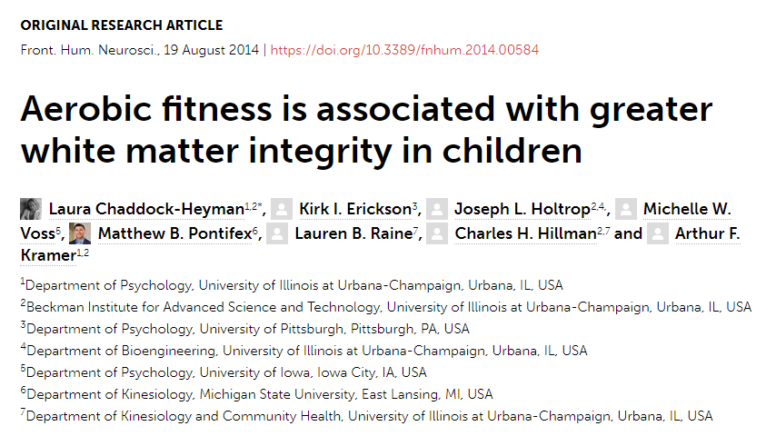
INFLUENCE OF EXERCISE ON WHITE MATTER

Slide 50
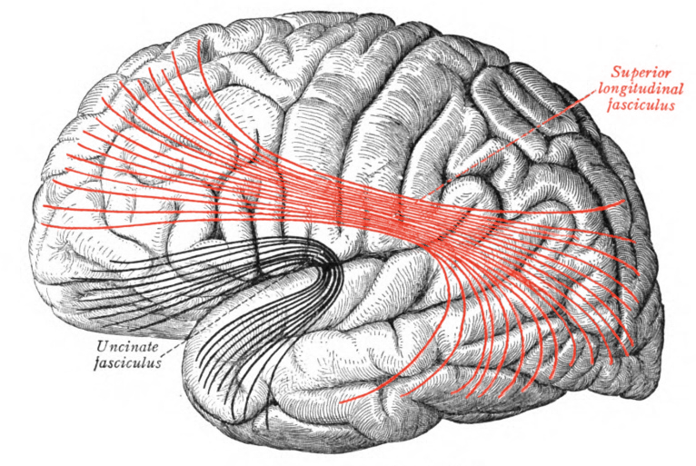
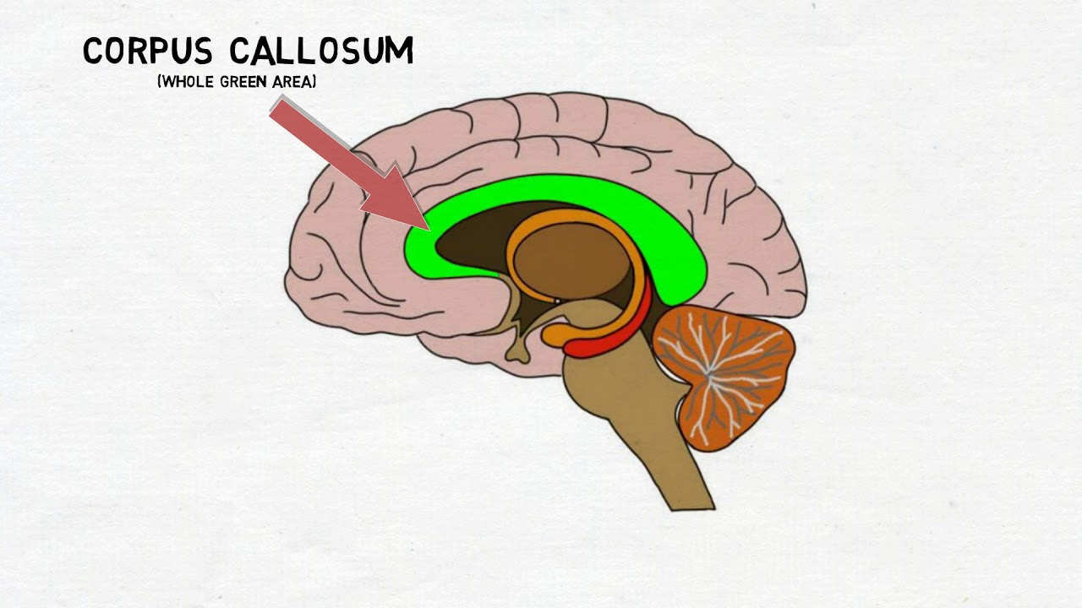
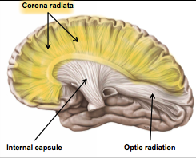
INFLUENCE OF EXERCISE ON WHITE MATTER
Aerobic fitness has been found to play a positive role in brain and cognitive health of children. Yet, many of the neural biomarkers related to aerobic fitness remain unknown. Here, using diffusion tensor imaging, authors demonstrated that higher aerobic fitness was related to greater estimates of white matter microstructure in children. Higher fit 9- and 10-year-old children showed greater fractional anisotropy (FA) in sections of the corpus callosum, corona radiata, and superior longitudinal fasciculus, compared to lower fit children.
Notes:
Fractional anisotropy (FA) is a scalar value between zero and one that describes the degree of anisotropy of a diffusion process. A value of zero means that diffusion is isotropic, i.e. it is unrestricted (or equally restricted) in all directions.

Slide 51
INFLUENCE OF EXERCISE ON WHITE MATTER
Аerobic fitness plays an important role in the brain health of children, especially in terms of brain structure and brain function, including gray matter volumes [e.g., hippocampus, basal ganglia and functional brain networks (e.g., frontal and parietal cortex). These fitness-related differences in brain health are often coupled with performance differences, such that higher fit children have been shown to outperform their lower fit peers on tasks of cognitive control and memory as well as scholastic achievement tests in the classroom
Notes:
Ovde mozemo pricati o nedostatku istrazivanja zbog toga sto u obzir ne uzima socijalni status ispitanik I nacin zivota koji takodje imaju znacajan uticaj.

Slide 52
INFLUENCE OF EXERCISE ON WHITE MATTER
Authors predicted that higher fit children would show greater estimates of white matter microstructure than lower fit children. Because the structure and function of brain circuits important for cognitive control have been found to be sensitive to aerobic fitness authors focused on white matter tracts that relate to these cognitive skills, and that connect frontal, striatal and parietal brain areas. In particular, in this first exploration of the association between aerobic fitness and white matter microstructure in children, authors examined a priori white matter tracts. These tracts included the corpus callosum, which connects the left and right cerebral hemispheres, the corona radiata which carries ascending and descending information throughout the brain, and the superior longitudinal fasciculus, a tract that provides bidirectional information transfer between the frontal and parietal cortex. Additionally, authors examined the posterior thalamic radiation, nerve fibers connecting the thalamus and caudate nucleus with the cerebral cortex, and the cerebral peduncle, part of the brainstem, which includes nerve tracts carrying motor information to and from the brain to the rest of the body. This study contributes to our understanding of plasticity of the microstructure of white matter that allows efficient communication between gray matter areas in the brain and integrates the brain into networks important for cognition and academic achievement.

Slide 53
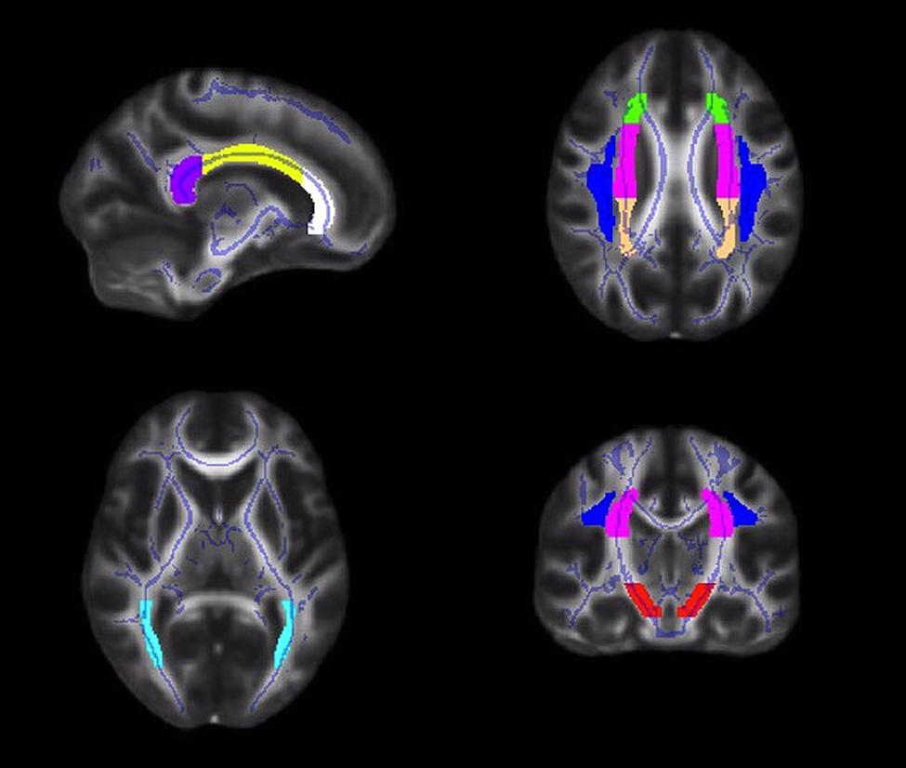
INFLUENCE OF EXERCISE ON WHITE MATTER
FIGURE 1. Illustrations of the white matter tract ROIs in the corpus callosum (white = genu; yellow = body; purple = splenium), corona radiata (anterior = green; superior = pink; posterior = peach), superior longitudinal fasciculus (blue), posterior thalamic radiation (light blue), and cerebral peduncle (red)

Slide 54
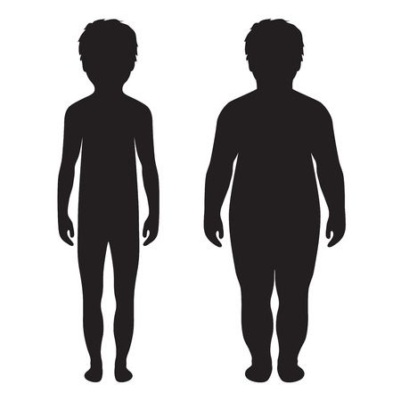
INFLUENCE OF EXERCISE ON WHITE MATTER
The present study is the first to demonstrate that aerobic fitness is positively related to the microstructure of white matter fiber tracts in the brain during childhood. Higher fit 9- and 10-year-old children showed greater FA in sections of the corpus callosum, corona radiata, and superior longitudinal fasciculus, compared to lower fit children.
HIGHER FIT CHILDREN
(>70th percentile VO2max)
LOWER FIT CHILDREN
(<30th percentile VO2max)

Slide 55
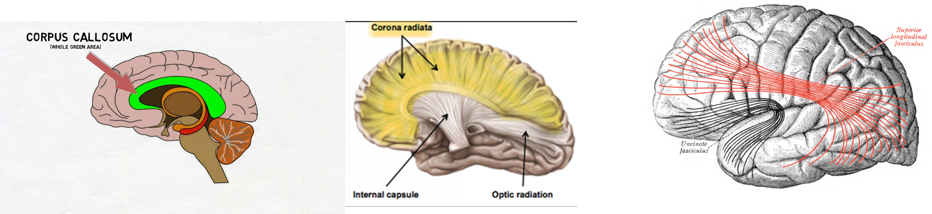
INFLUENCE OF EXERCISE ON WHITE MATTER
An exploration of the components of the diffusion tensor showed that the relationships between aerobic fitness and FA were primarily characterized by fitness group differences in RD. Because axonal caliber and thickness of the myelin sheath determine conduction velocity.
The results raise the possibility that children with higher fitness levels may have faster neural conduction between brain regions important for cognitive control. White matter microstructure may be another potential neural mechanism of aerobic fitness that assists in efficient communication between gray matter and the integration of regions into networks to support cognitive function and academic achievement.
Notes:
We analyzed fractional anisotropy (FA), a general index of white matter microstructure, hypothesized to be higher in tightly bundled, structurally compact fibers with high integrity (Basser, 1995; Beaulieu, 2002; Sen and Basser, 2005; Rykhlevskaia et al., 2008). We also explored specific patterns of diffusivity [radial diffusivity (RD) and axial diffusivity (AD)], hypothesized to reflect potential biological properties of white matter microstructure

Slide 56
INFLUENCE OF EXERCISE ON WHITE MATTER
These results arrive at an important time, as children become increasingly unfit and sedentary, and educators reduce or eliminate opportunities for physical activity during the school day in favor of academic topics.
In fact, white matter microstructure in the corona radiata has been found to relate to mathematics performance in the classroom, which raises the possibility that the removal of fitness training opportunities during the school day may unintentionally have deleterious effects on white matter tracts, potentially reducing scholastic achievement.

Slide 57
INFLUENCE OF EXERCISE ON WHITE MATTER
In fact, this study raises the possibility that greater white matter integrity, perhaps via greater myelination, is one pathway by which higher fit children excel in cognitive and academic performance compared to their less fit peers. Hopefully these findings will reinforce the importance of aerobic fitness during development and lead to additional physical activity opportunities in and out of the school environment.

Slide 58
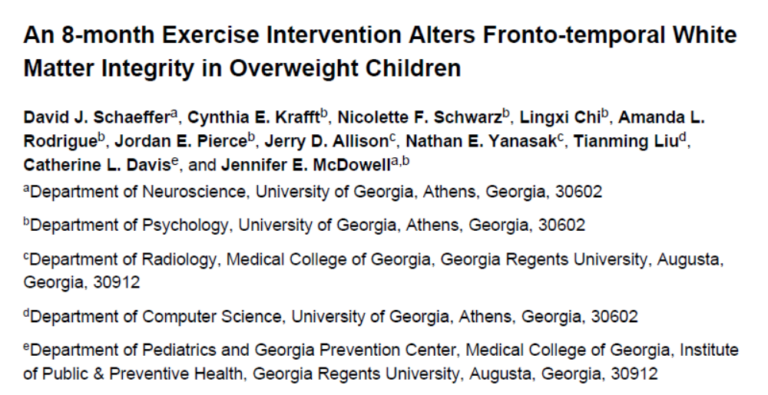
INFLUENCE OF EXERCISE ON WHITE MATTER

Slide 59
INFLUENCE OF EXERCISE ON WHITE MATTER
Participants 8–11 years old
For the exercise group, children participated for 60–75 minutes each day, including time to dress and transition, and 40 minutes of instructor led aerobic activities (e.g., tag or jump rope). Each child wore a heart rate monitor during every training session (S610i; Polar Electro, Oy, Finland) and the child’s average heart rate during the session was recorded every day.
In the attention control group, instructors led sedentary activities (e.g., art and board games) for 60–75 minutes daily.

Slide 60
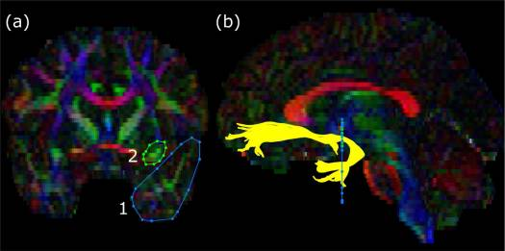
INFLUENCE OF EXERCISE ON WHITE MATTER
Regions of interest for the uncinate fasciculus overlaid on a representative subject’s fractional anisotropy map. The colors of the map represent the principal direction of diffusion (red = left-right, green = anterior-posterior, blue = inferior-superior). The left panel (a) shows the locations of the regions of interest (1, temporal lobe; 2, frontal lobe) drawn on a coronal slice. The right panel (b) shows the resultant fibers of the uncinate fasciculus (yellow) traversing the regions of interest against a sagittal slice.

Slide 61
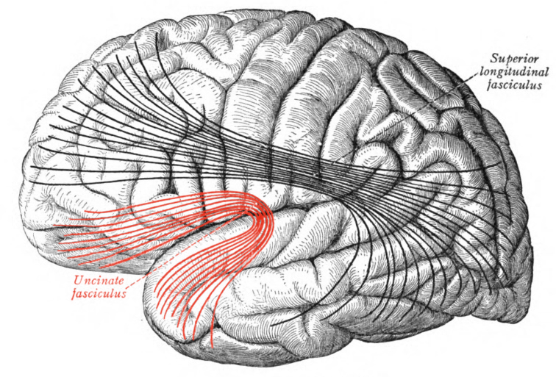
UNCINATE FASCICULUS
The uncinate fasciculus is a white matter association tract in the human brain that connects parts of the limbic system such as the hippocampus and amygdala in the temporal lobe with frontal ones such as the orbitofrontal cortex.

Slide 62
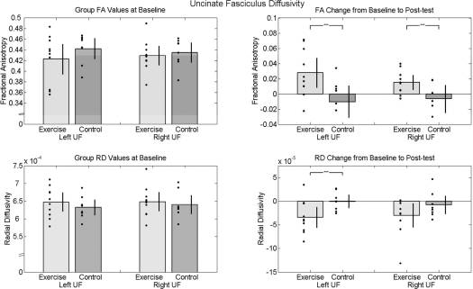
Notes:
Diffusivity values of uncinate fasciculus at baseline and post-test. The bar graphs show mean diffusivity values for each group (gray and dark gray bars) and standard error bars with individual data points (black dots) overlaid. The left panel shows that the two groups did not significantly differ in left or right uncinate fasciculus white matter integrity (FA and RD) at baseline. The right panel illustrates the increase from baseline to post-test in white matter integrity (increased FA and decreased RD) in the exercise group as compared to the control group. The black brackets with asterisks indicate a significant t test at alpha = .05 (controlled for race and gender).

Slide 63
PHYSICAL ACTIVITY CAN INCREASE WHITE MATTER MICROSTRUCTURE IN CHILDREN
The findings from the present study suggest that participation in an after school exercise program increases fronto-temporal white matter integrity in unfit children who are overweight or obese.
Because increased white matter integrity is related to improved cognitive function in children, the present results might inform education policy by demonstrating physical activity effects on children’s brain structure.

Slide 64
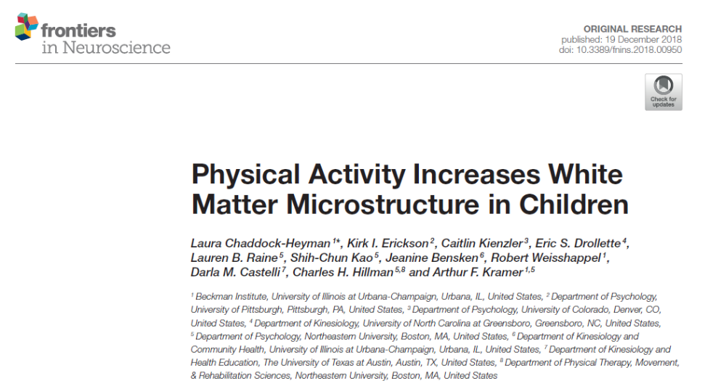

Slide 65
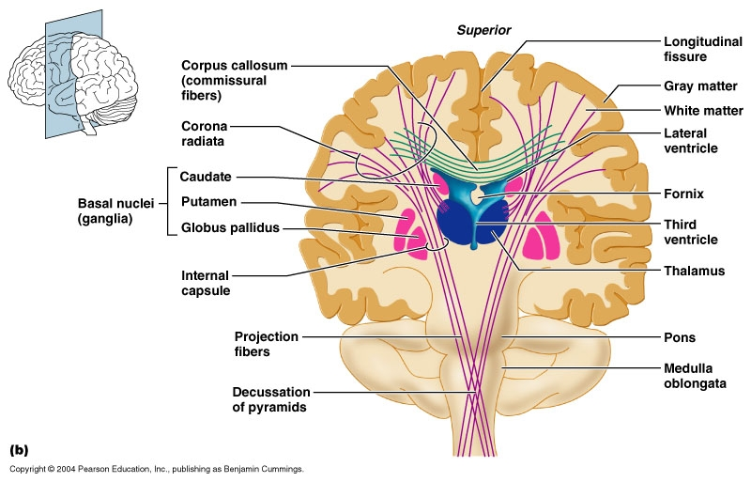

Slide 66
The present study examined the effects of an after-school physical activity program on the microstructure of white matter tracts in children. Maturation of white matter tracts is an important element of development, as microstructural integrity of white matter is required for efficient transmission of information between gray matter as well as the integration of brain areas into structural networks to support cognitive function.

Slide 67
IMAGING OF CHANGES IN BRAIN
Authors used diffusion tensor imaging (DTI) which allows scientists to indirectly quantify the microstructural components of white matter, including myelination and axonal organization. In general, developmental studies using diffusion weighted imaging techniques demonstrate age-related increases in fractional anisotropy (FA) coupled with decreases in diffusivity (radial diffusivity [RD] and axial diffusivity [AD]) in most white matter regions, thereby suggesting increased axon caliber and myelin content as well as changes in fiber packing density with development. Specifically, FA is a general index of white matter microstructure, hypothesized to be higher in tightly bundled, structurally compact fibers with high integrity. RD is often used as a marker of myelination, and AD is known to be sensitive to changes in axonal fibers including axonal diameter, loss or damage.

Slide 68
EXPERIMENTAL DESIGN OF STUDY
In this study authors measured aerobic fitness (VO2max) and the microstructural properties (FA, RD, AD) of white matter in 7–9-year-old children before and after randomization into a 9-month physical activity intervention or a wait list control group (which reflects typical development over that period of time). By examining the effects of physical activity on multiple measures of diffusivity (FA, RD, AD), authors were able to test the influence of physical activity on specific microstructural white matter properties during childhood.

Slide 69
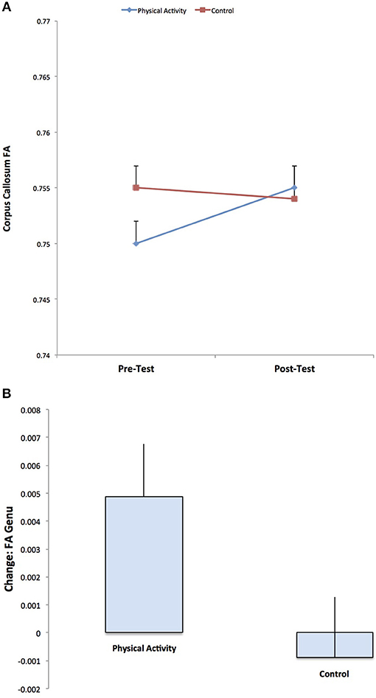
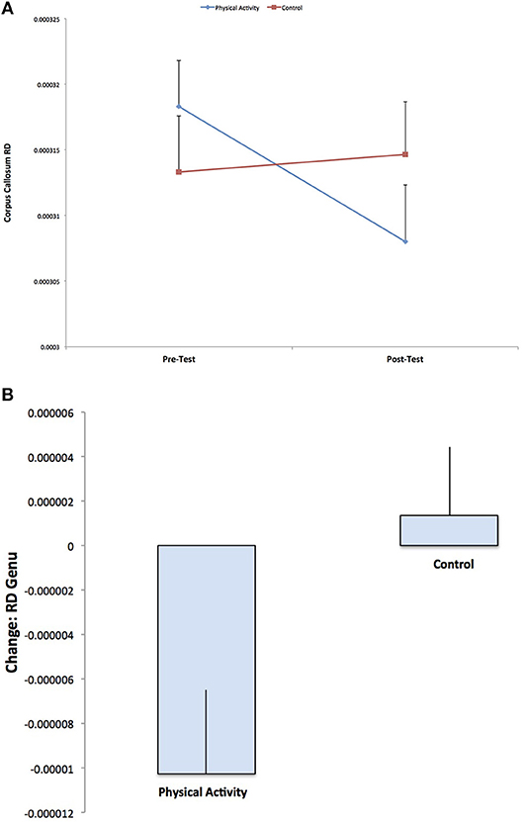
Physical activity group show significant increases in FA from pre-test to post-test, and no changes in FA for the control group. The result suggests increased estimates of white matter microstructure and fiber integrity with physical activity participation.
Physical activity group show significant decreases in RD from pre-test to post-test, with no changes in RD for the control group (p = 0.592). The result suggests increased estimates of white matter myelination with physical activity participation

Slide 70
PHYSICAL ACTIVITY TRAINING INTERVENTION INCREASED WHITE MATTER MICROSTRUCTURE
In conclusion, a 9-month randomized controlled physical activity intervention significantly improved estimates of structural integrity and myelination of the genu of the corpus callosum. Given that no significant changes were observed for children assigned to the wait list control group, the key implication from this study is that participating in an after-school physical activity program enhances the microstructure of the anterior corpus callosum, which may suggest faster neural conduction between brain hemispheres.

Slide 71

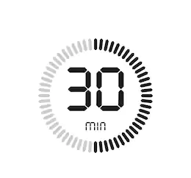



Slide 72
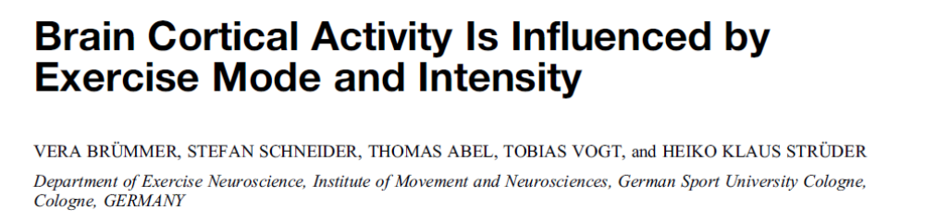

Slide 73
BRAIN CORTICAL ACTIVITY IS INFLUENCED BY EXERCISE MODE AND INTENSITY
Hypothesis of this research:
exercise has an effect on (pre-) frontal brain areas, which is expressed in the transient hypofrontality hypothesis and the dual-mode theory;
the effect of exercise depends on the chosen exercise intensity, which is expressed in the dose–response relationship; and
it depends on the chosen exercise type according to the individual bias as stated in the exercise preference hypothesis.

Slide 74
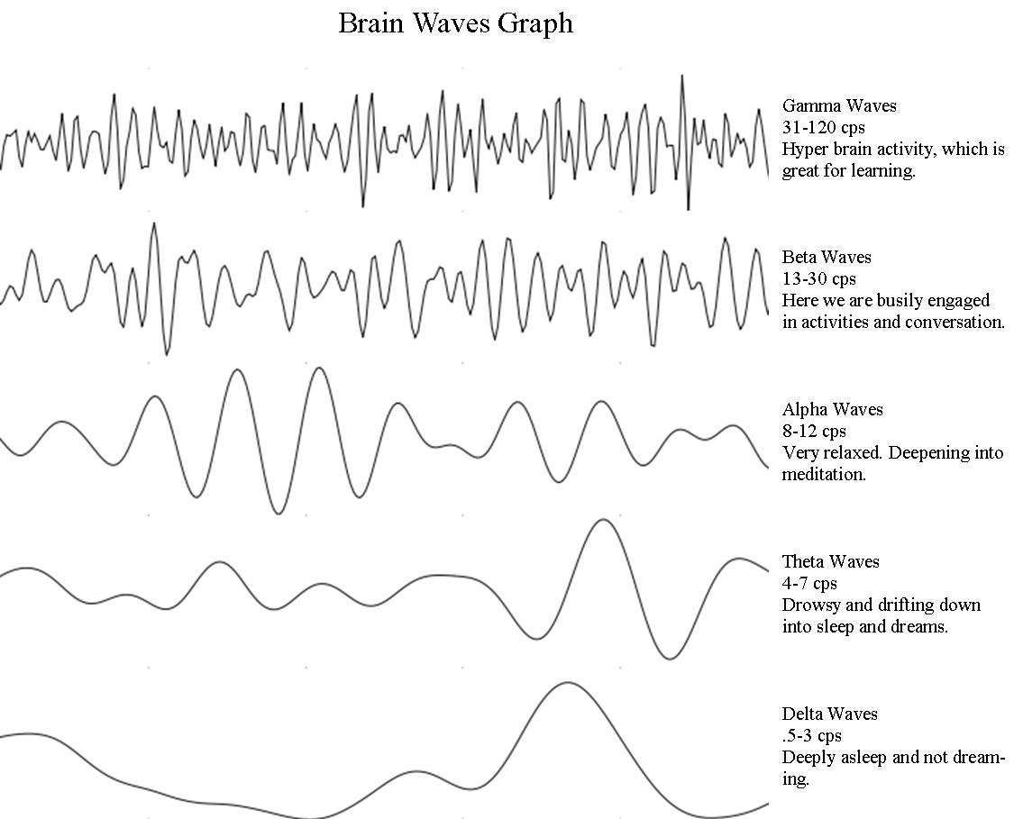
Investigations of changes in brain cortical activity induced by exercise have predominantly been made by electroencephalographic (EEG) recordings.

Slide 75
BRAIN CORTICAL ACTIVITY IS INFLUENCED BY EXERCISE MODE AND INTENSITY
The transient hypofrontality hypothesis assume that because of limited brain resources, intensive exercise is accompanied by a redistribution of the brain activity. The result is a shift of activity away from brain regions that are not involved in the task toward regions that are involved in planning and executing motor commands (mainly, the motor and sensory cortexes). Therefore, regions not involved in the demanding task of exercise (such as the prefrontal cortex) show less activity.

Slide 76
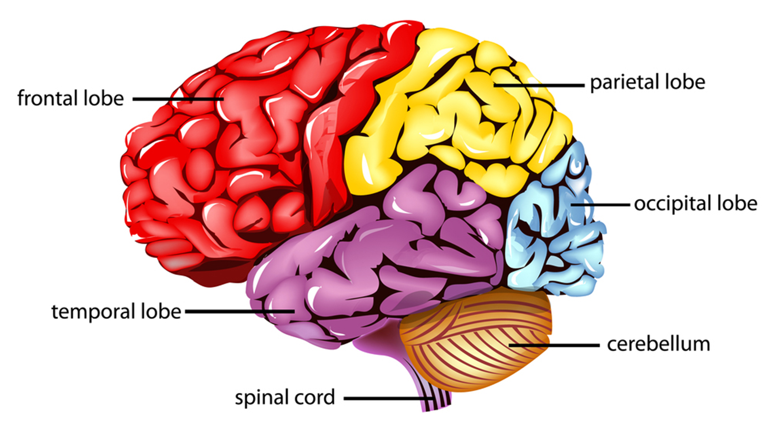
BRAIN CORTICAL ACTIVITY IS INFLUENCED BY EXERCISE MODE AND INTENSITY
Similarly, it has been shown that emotional brain areas in the prefrontal cortex are involved in learning a novel task and that activity shifts more and more toward parietal motor and somatosensory regions with practice.

Slide 77
DOSE–RESPONSE RELATIONSHIP
A dose–response relationship was proposed by Ekkekakis et al. and Ekkekakis and Petruzzello, regarding the effect of different exercise intensities. They suggested that the psychological effect of exercise which is thought to be mediated by changes in brain cortical activity is intensity dependent. Whereas low-intensity exercise is thought to be insufficient to have a positive influence, high intensive exercise in turn is thought to be counterproductive. The optimal exercise intensity for the greatest psychological effect is somewhere in between these two extremes. This relationship between exercise intensity and brain cortical activity seems to be dependent upon the trained status of an individual.

Slide 78

DOSE–RESPONSE RELATIONSHIP
Higher but not moderate exercise intensities resulted in decreased BETA activity and reduced psychological strain in recreational athletes. These studies highlight the importance of regarding the effect of different exercise intensities on changes in brain cortical activity as an underlying neurophysiologic mechanism.

Slide 79
DOSE–RESPONSE RELATIONSHIP
Decreased cortical activation in frontal cortex areas seems to be connected to exercise preferences. The ‘‘exercise preference hypothesis’’ is built on the assumption that the relaxation effects of exercise are linked to an individual’s physical activity history and exercise preferences, where the ‘‘preferred exercise’’ represents the mode of exercise a subject is most familiar with. In combination with the dual-mode/hypofrontality theory, one would assume that exercise in accordance with an individual’s physical activity history and preference would be accompanied by frontal deactivation.

Slide 80
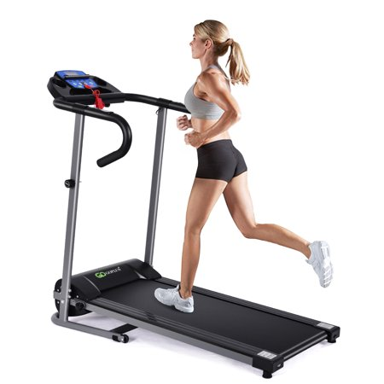


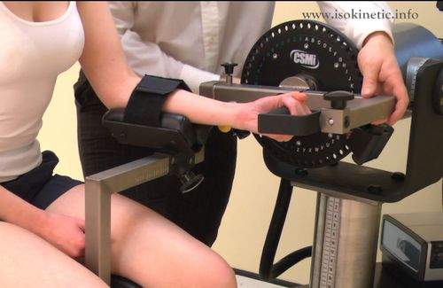
ELECTROCORTICAL CHANGES IN BRAIN REGIONS INDUCED BY DIFFERENT EXERCISE MODES
treadmill
bicycle
arm crank
isokinetic wrist flexion exercises

Slide 81
ELECTROCORTICAL CHANGES IN BRAIN REGIONS INDUCED BY DIFFERENT INTENSITIES
50% of individual aerobic or strength capacity
80% of individual aerobic or strength capacity

Slide 82
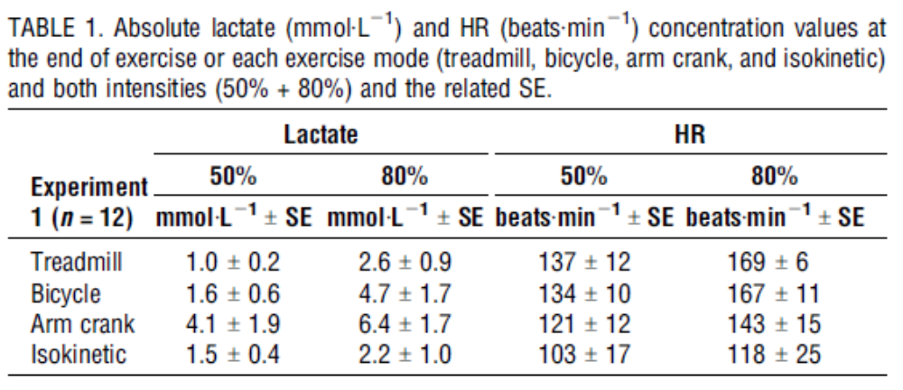
ELECTROCORTICAL CHANGES IN BRAIN REGIONS INDUCED BY DIFFERENT EXERCISE MODES & INTENSITIES

Slide 83
ALPHA BRAIN WAVES
Alpha waves generally are seen in all age groups but are most common in adults. They occur rhythmically on both sides of the head but are often slightly higher in amplitude on the nondominant side, especially in right-handed individuals. A normal alpha variant is noted when a harmonic of alpha frequency occurs in the posterior head regions. They tend to be present posteriorly more than anteriorly and are especially prominent with closed eyes and with relaxation.
Alpha activity disappears normally with attention (eg, mental arithmetic, stress, opening eyes). In most instances, it is regarded as a normal waveform.
Increasing alpha brain waves can stimulate creativity and minimize depression.

Slide 84
BETA BRAIN WAVES
Beta brainwaves dominate our normal waking state of consciousness when attention is directed towards cognitive tasks and the outside world. Beta is a ‘fast’ activity, present when we are alert, attentive, engaged in problem solving, judgment, decision making, or focused mental activity.
Beta brainwaves are further divided into three bands; Lo-Beta (Beta1, 12-15Hz) can be thought of as a 'fast idle', or musing. Beta (Beta2, 15-22Hz) is high engagement or actively figuring something out. Hi-Beta (Beta3, 22-38Hz) is highly complex thought, integrating new experiences, high anxiety, or excitement. Continual high frequency processing is not a very efficient way to run the brain, as it takes a tremendous amount of energy.
They tend to be small in amplitude and usually are symmetric and more evident anteriorly.

Slide 85
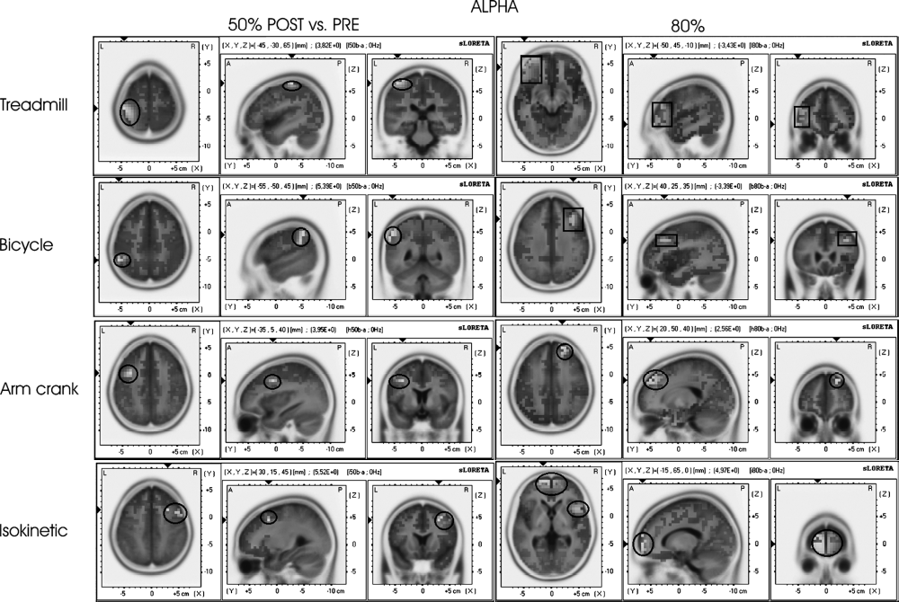
= decrease
= increase
Notes:
Smanjenje alfa talasa kod visokointenzivnih aktivnosti nastaje zbog vrlo napornog intenziteta koji je ispitaniku NEPRIJATAN i ulazi u stanje neprijatnosti.
Arm crank I Izokinetik na 80% nove aktivnosti izazivaju pozitivan podsticaj resavanja zadatka I

Slide 86
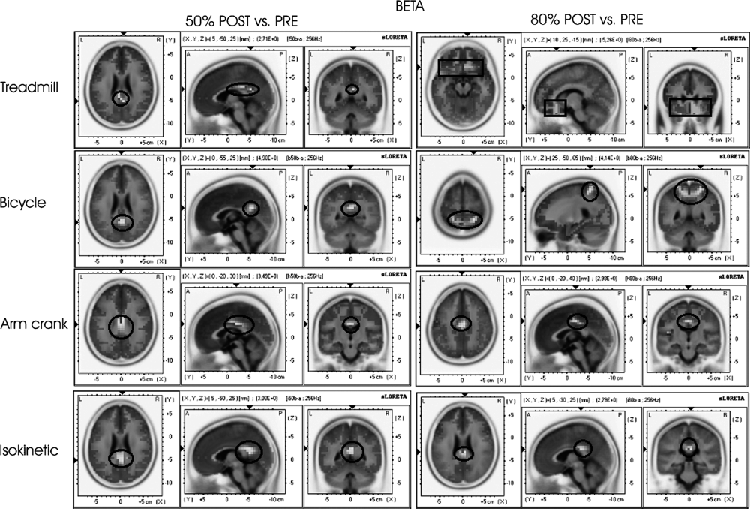
= decrease
= increase

Slide 87
Localized electromagnetic tomography revealed that Alpha activity increased in the parietal brain regions related to somatosensory perception (BA 1, 2, 5, 7) after the treadmill and bicycle exercises and mainly in frontal brain regions related to emotional and sensory processes after the arm crank (BA 6, 9) and isokinetic exercises (BA 8, 9, 32). Because the subjects were most familiar with running and bicycling but not with arm crank and isokinetic exercises, these findings indicate that more familiar types of exercise lead to increases in ALPHA activity in somatosensory regions and that unfamiliar types of exercise lead to increases in ALPHA activity in emotion centers.

Slide 88
TAKE HOME MESSAGES
Physically active children rich better academic achievement
Exercise helps memory and thinking
Exercise improve attention
Exercise can produce positive changes of brain structures and functions
Parts of the brain that control thinking and memory (the prefrontal cortex and medial temporal cortex) have greater volume in physically active children versus children who are not active.
Inactivity is killing our brains
EXERCISE CAN MAKE OUR CHILDREN SMARTER

Slide 89
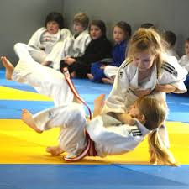


Slide 90
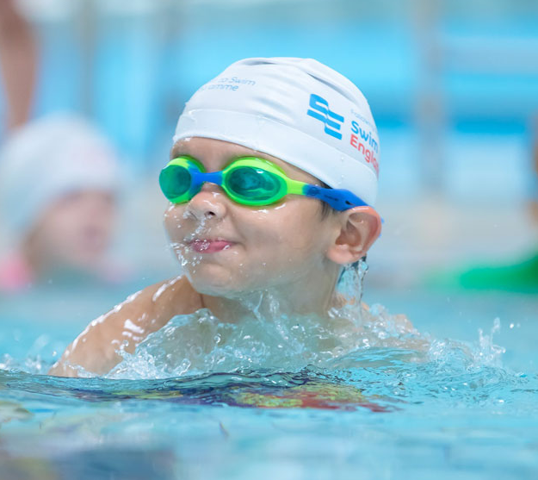
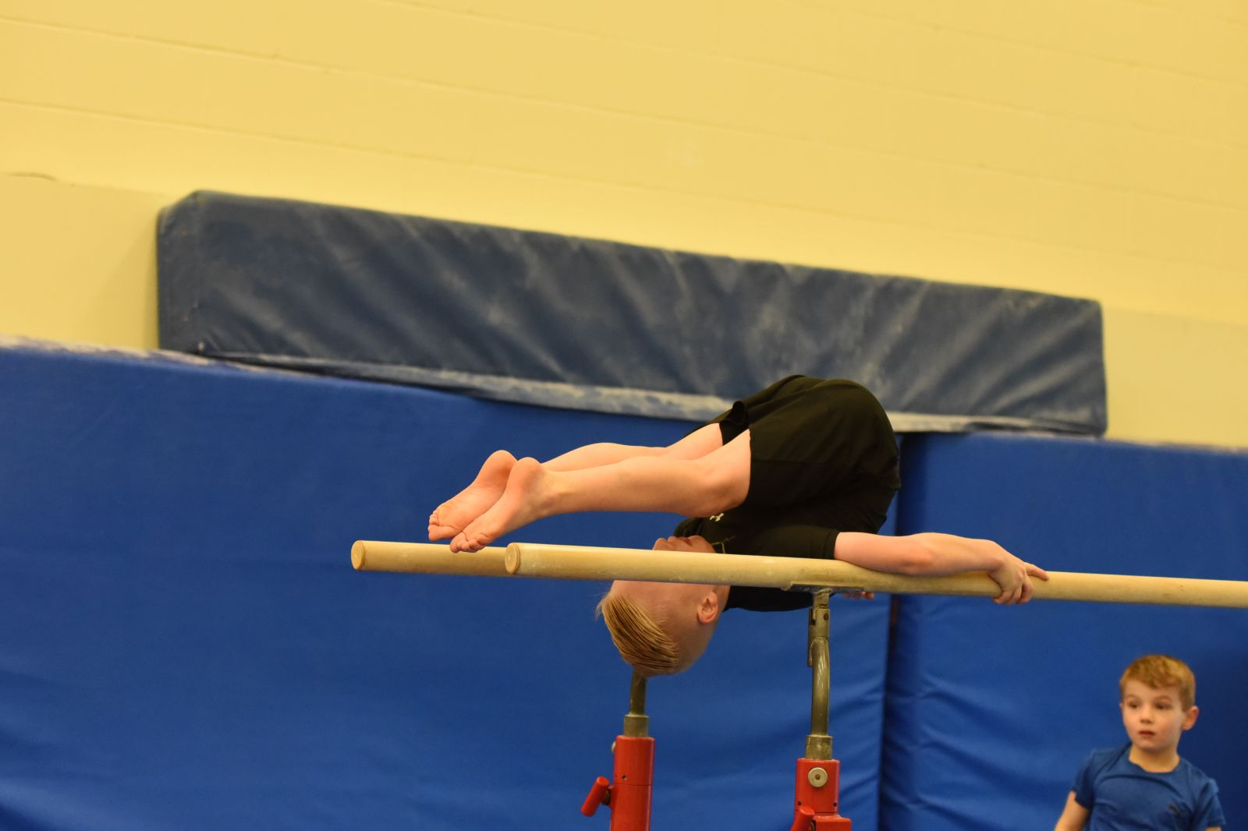

Slide 91



Slide 92
SUPERCALIFRAGILISTICEXPIALIDOCIOUS
YOU WERE GRAND, GREAT, GLORIOUS, SPLENDID, SUPERB, & WONDERFUL AUDIENCE
THANK YOU FOR YOUR ATTENTION

